Slide 1

React & Patterns
BDDF SOCLE 2023

Slide 2
outline
React : an outside view
React : an inside view
React DO & DON’T
Conditional Rendering
Practical example
React Tips
Error Boundary
Thinking in React
Presentational Components
React Components
React Components Types
Web Page Overview
React Composition
Container Components
React state & props
React Life Cycle
React virtual DOM
Top Down Data Flow
One way data binding
Lazy Routes
Lazy Component

Slide 3
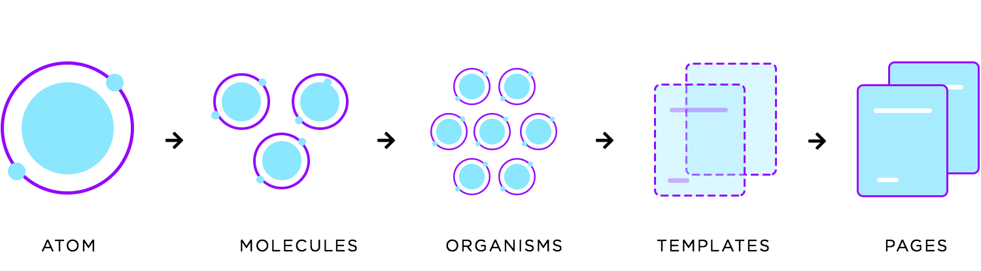
React : an outside view

Slide 4
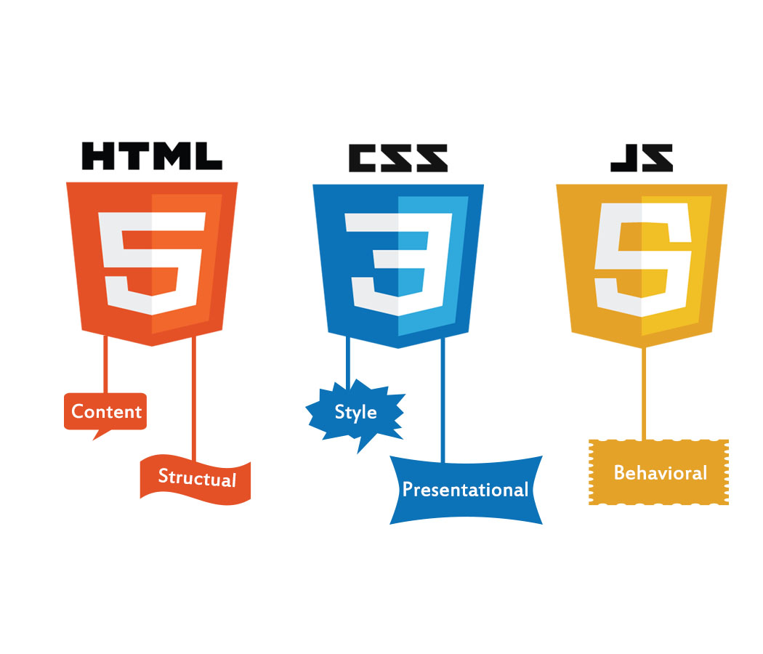

Web page
HTML + CSS + JS + A11y

Slide 5
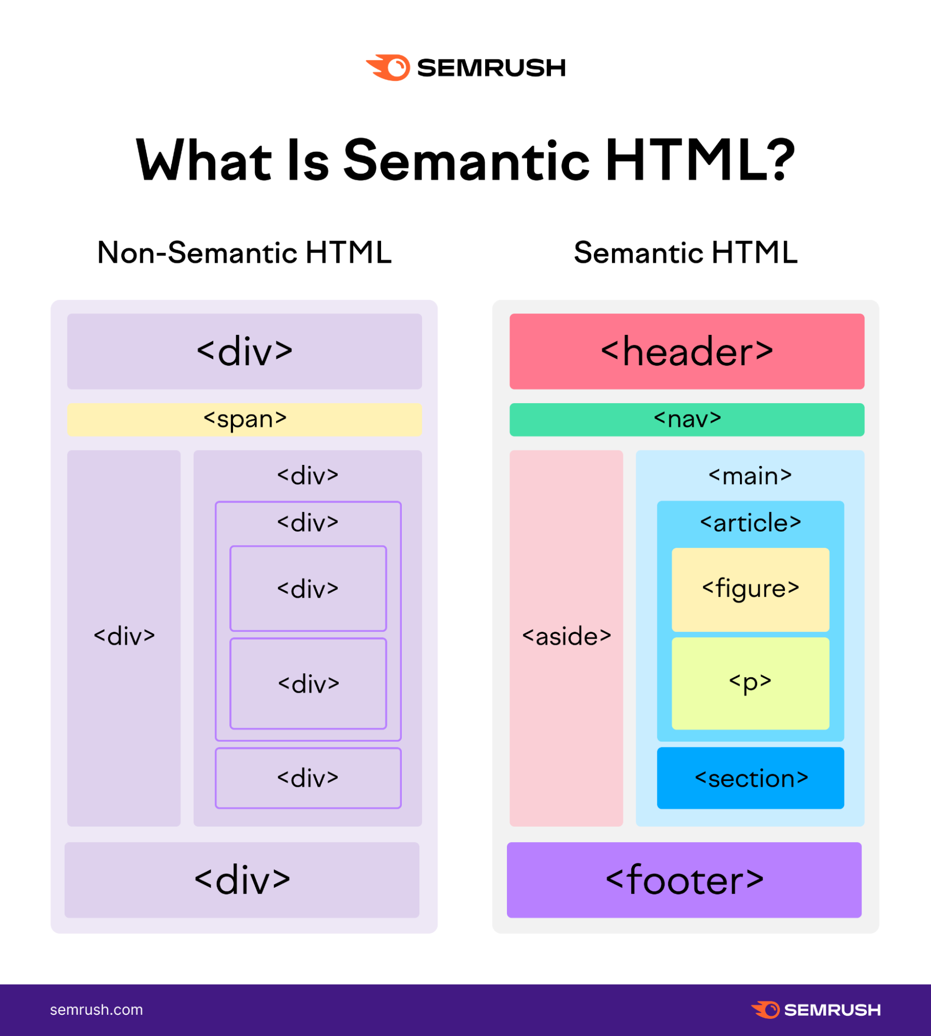
Semantic html
https://web.dev/learn/html/semantic-html/
Writing semantic HTML means using HTML elements to structure your content based on each element's meaning, not its appearance.

Slide 6
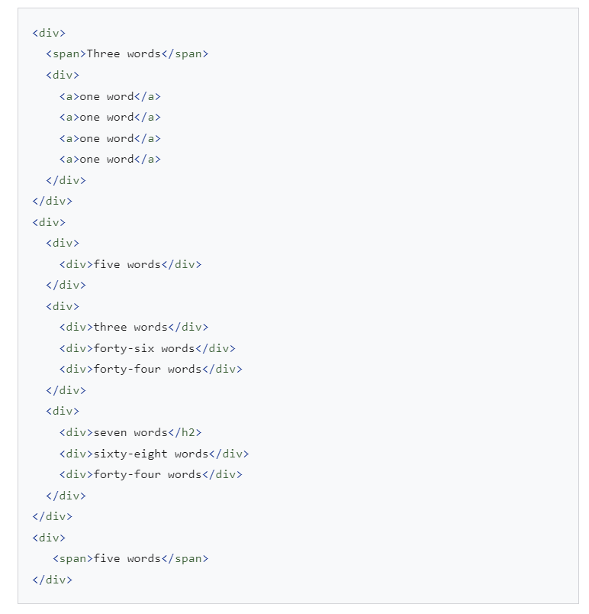
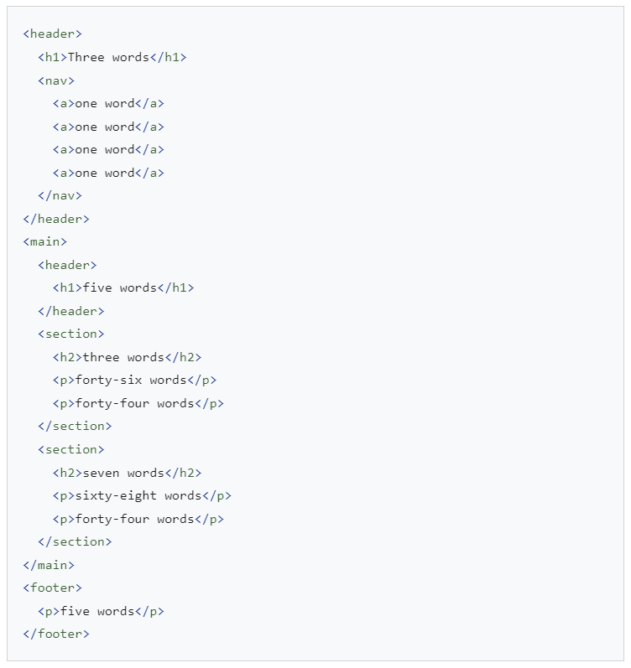
Semantic html
Non-Semantic HTML
Semantic HTML

Slide 7
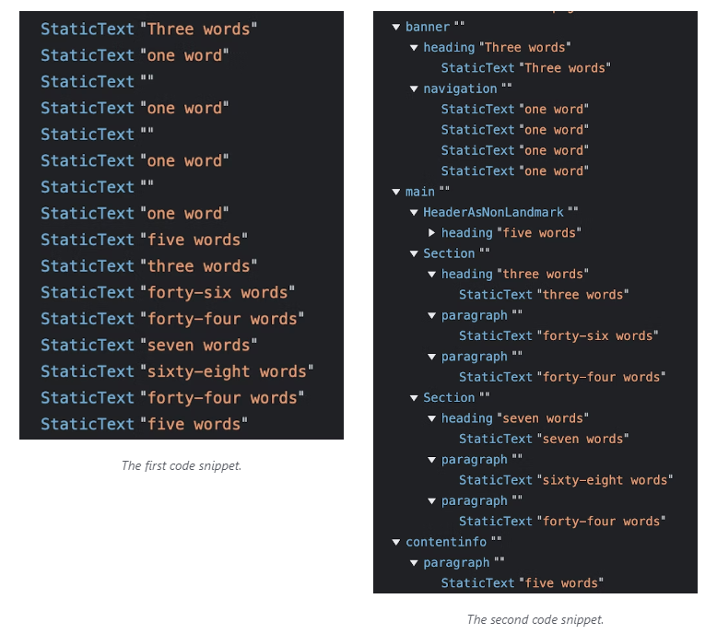
Semantic html
Non-Semantic HTML
Semantic HTML

Slide 8
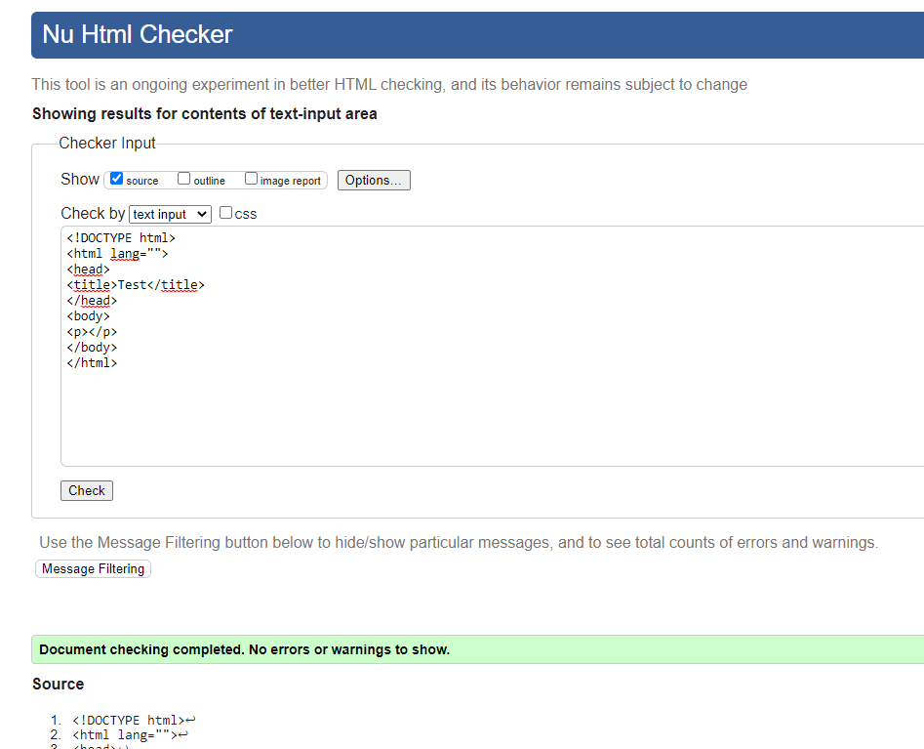
Semantic html validation
https://validator.w3.org/nu/#textarea

Slide 9
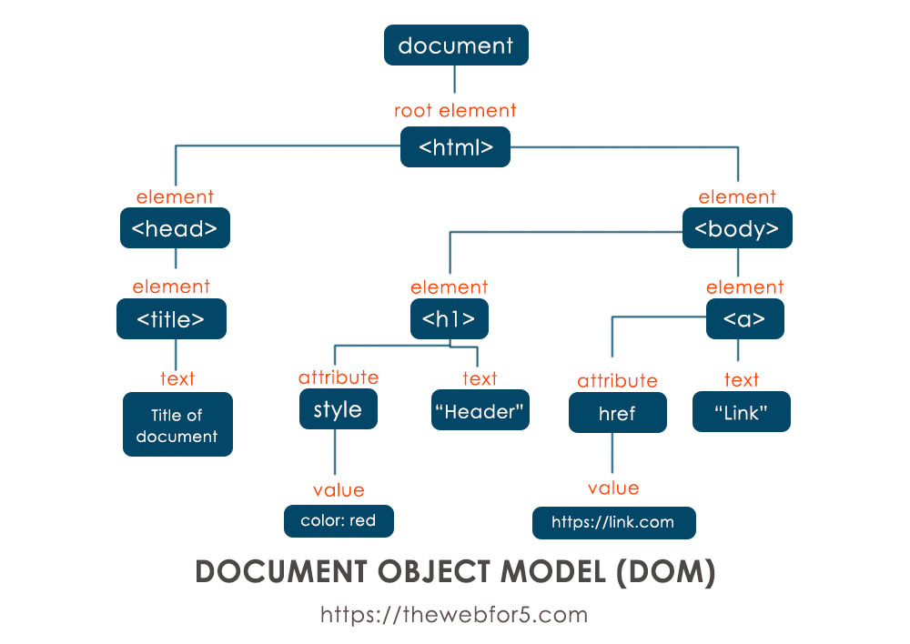
Html dom

Slide 10
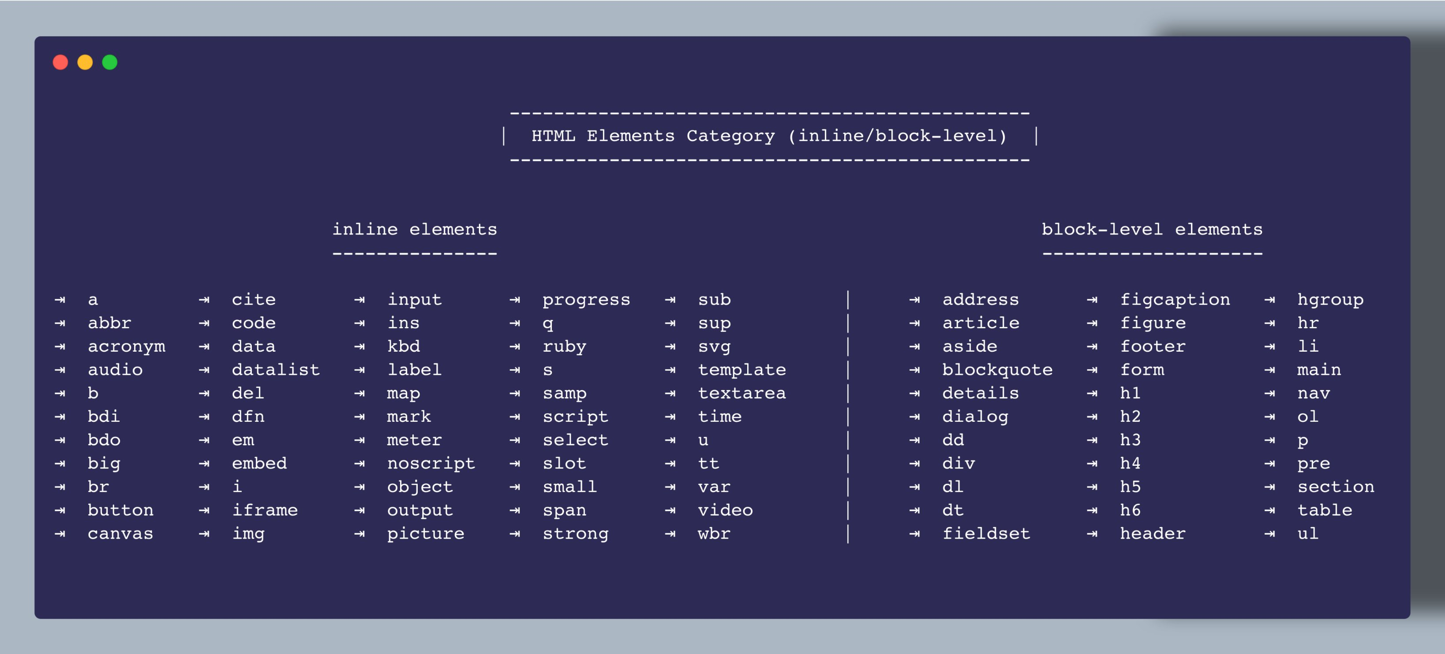
Html elements

Slide 11
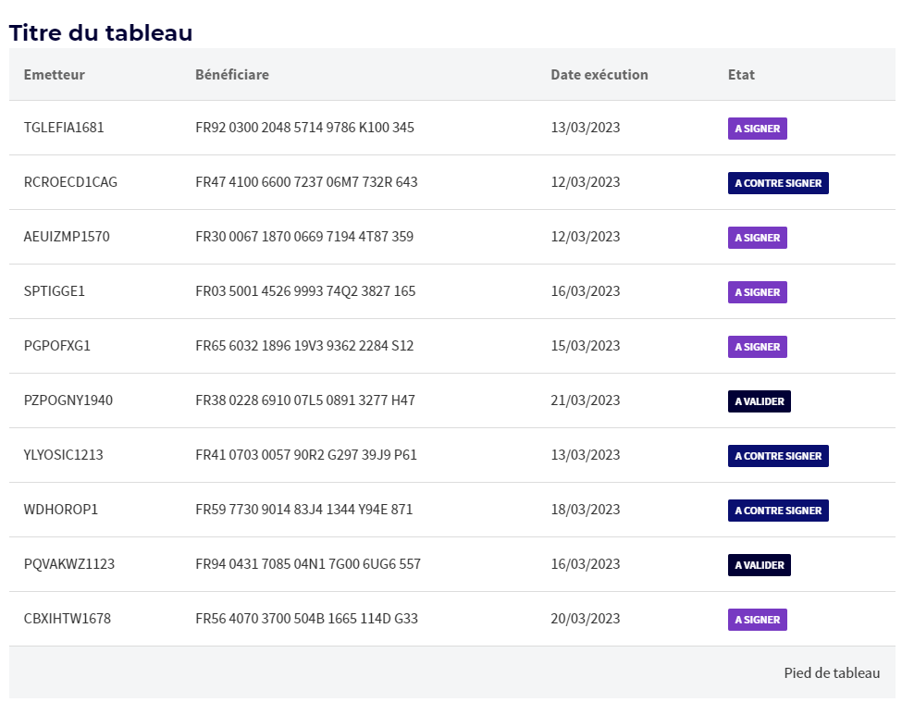

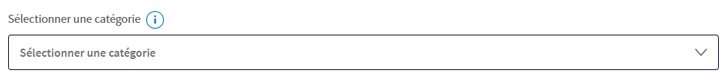
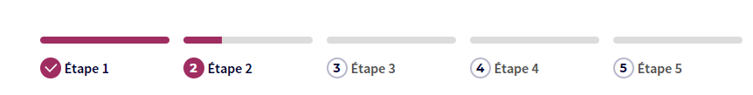
Sgc+ react elements
<SGButton type="secondary" onClick={() => console.log('Primary button clicked')} > Primary Button </SGButton>
<SGTitle level={2} visualLevel={4} > Titre </SGTitle>
http://socle.applis.bad.socgen/icd/static/sg-components-plus/latest/?path=/story/sg-components-ui-kit--pr%C3%A9sentation
<SGText type="amount" size="xl" strong > 0 € </SGText>

Slide 12
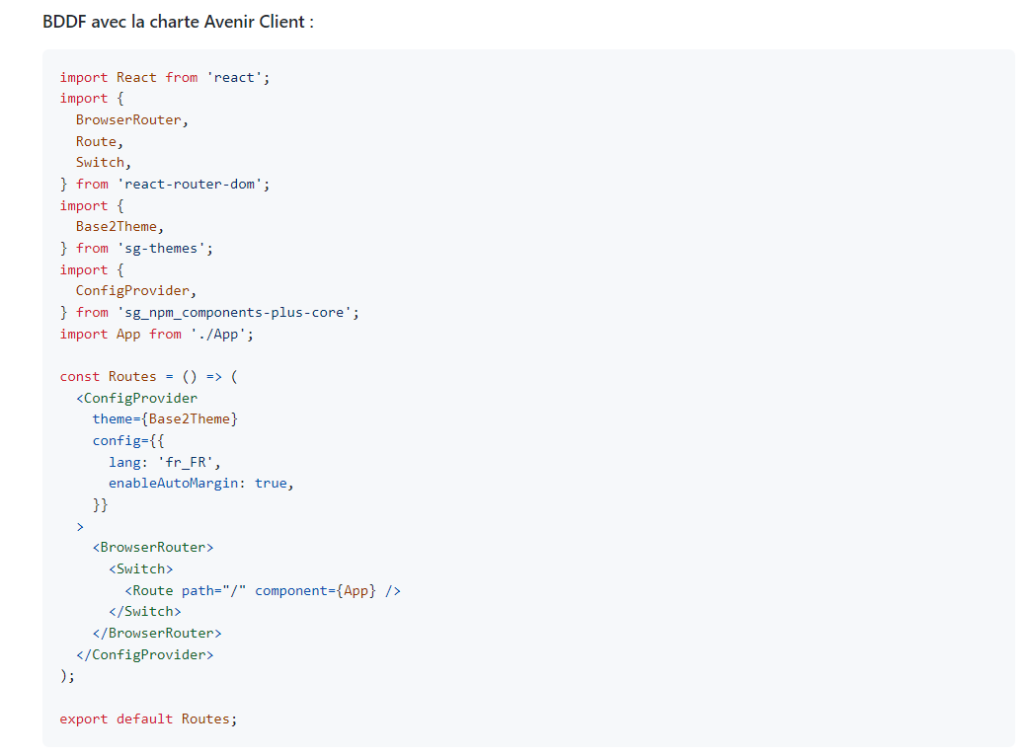
Theme
https://sgithub.fr.world.socgen/AppliDigitalClient/sg_npm_sgc_components-plus/wiki/Int%C3%A9grer-la-librairie-dans-un-projet

Slide 13
Html
CSS
SGC+
JS
Ay11
Do not use html elements but rather SGC+ components !

Slide 14
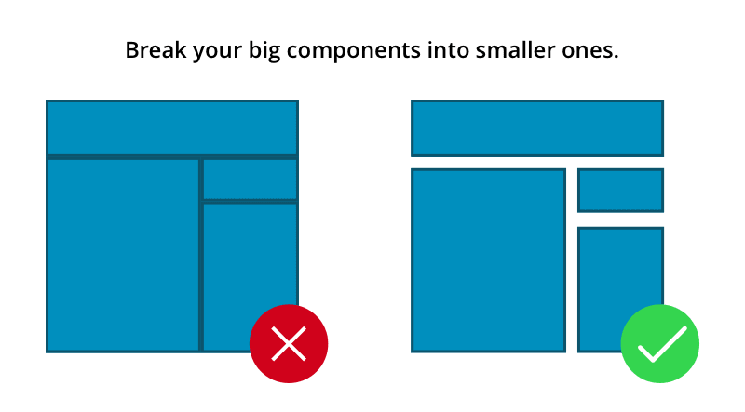
react
Divide the UI into several parts

Slide 15
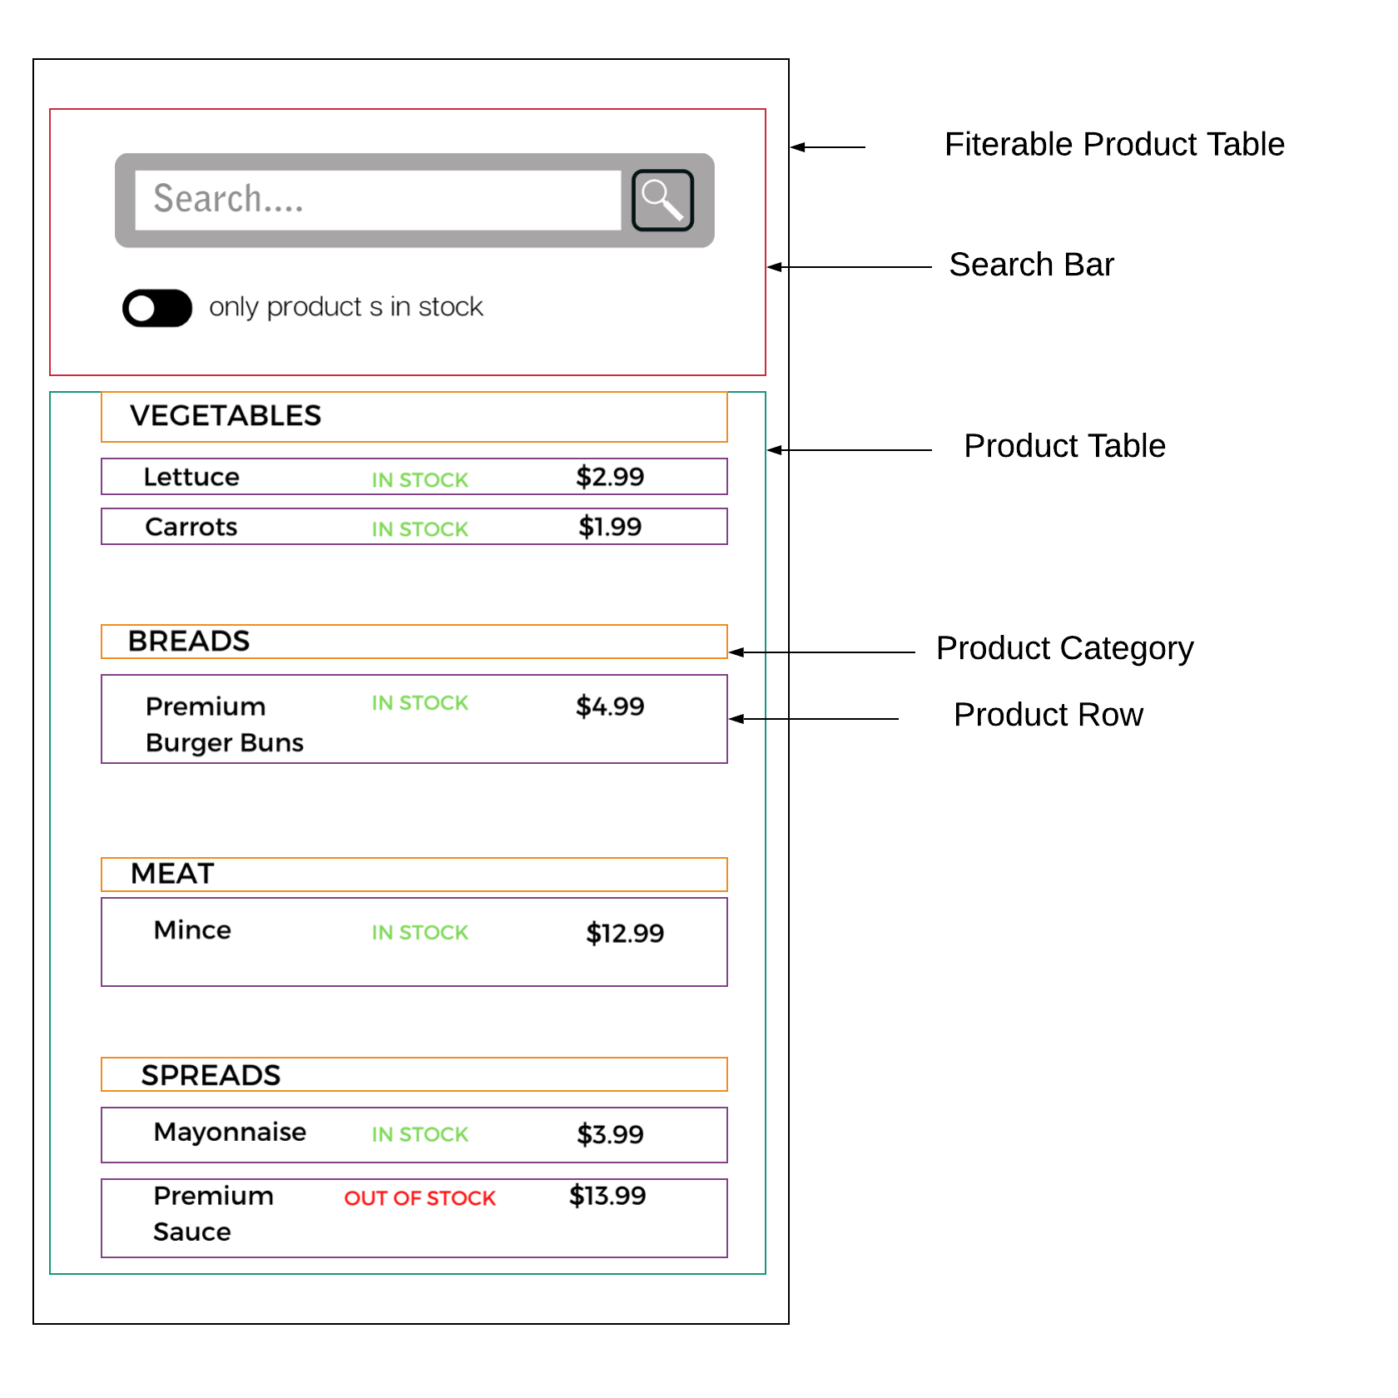
react
Divide the UI into several parts

Slide 16
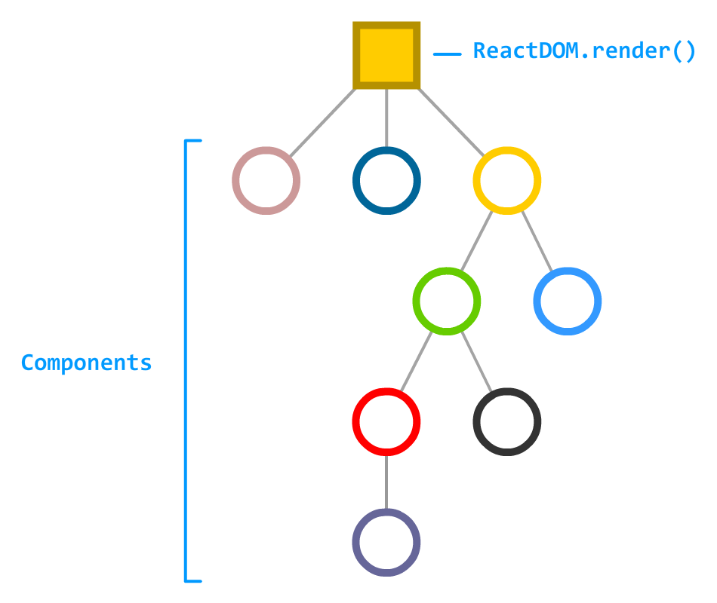
UI Part = Component
Unit of work = component

Slide 17

React component (declaration)
const HouseLoadingView = ({ title, message, }) => ( <SGBox margin={{ top: 'md', }} > <SGSpinner size="lg" tip={( <> <SGTitle visuallevel={4}> {title} </SGTitle> <SGText> {message} </SGText> </> )} /> </SGBox> );
Inputs
Declarative : what to do !

Slide 18
React component (declaration)
const HouseLoadingView = ({ title, message, }) => ( <SGBox margin={{ top: 'md', }} > <SGSpinner size="lg" tip={( <> <SGTitle visuallevel={4}> {title} </SGTitle> <SGText> {message} </SGText> </> )} /> </SGBox> );
Parent
Child
SGSpinner is the child of SGBox

Slide 19
React component (declaration)
const HouseLibListItem = ({ words, lib, onOpenLibDetailsClicked, }) => { const dataSource = formatLibInfos({ words, lib, }); return ( <SGListItem> <SGCard bordered actions={[ <SGBox span={onOpenLibDetailsClicked ? null : 12} textalign="left" margin={{ top: 'md', bottom: 'md', }} > <HouseTagView testpath="../js/commons/components/HouseTagView" tags={lib?.keywords} />
Some logic before returning the view to display
Declarative : what to do !

Slide 20
React component (use)
if (faqListLoading) { return ( <HouseLoadingView testpath="../js/commons/components/HouseLoadingView" title={words.HOUSE_DATA_LOADING_TITLE} message={words.HOUSE_DATA_LOADING_MESSAGE} /> ); }
<SGBox textalign="center" margin={{ top: 'md', }} > <SGList dataSource={npmList} loading renderItem={(npm) => ( <HouseLibListItem testpath="../js/commons/components/HouseLibListItem" lib={npm} onOpenLibDetailsClicked={onOpenNpmLibDetailsClicked} /> )} /> </SGBox>
The same component can be used several times with different inputs to have different displays ;)
Declarative : what to do !

Slide 21
rule
Inputs
Props
Props is read-only !

Slide 22
React component
const HouseSectionView = ({ sectionTitle, sectionContent, dark, actionsdivider, actions, }) => ( <SGCard dark={dark} actionsdivider={actionsdivider} actions={actions} > <SGCardMeta title={( <> {sectionTitle && ( <SGTitle caps level={4} textalign="center" visuallevel={3} > {sectionTitle} </SGTitle> )} </> )} titlebackground="dark" description={( <> {sectionContent} </> )} /> </SGCard> );
Assembly of several SGC+

Slide 23
React component
const HouseDashboardView = ({ onDashboardItemClicked, onRechercheSimpleClicked, onRechercheAvanceeClicked, }) => ( <> <HouseSearchBar testpath="../js/commons/components/HouseSearchBar" onRechercheSimpleClicked={onRechercheSimpleClicked} onRechercheAvanceeClicked={onRechercheAvanceeClicked} /> <SGRadioGroup name="house_menu_item" buttonstyle="tile" layout="column" showradio={false} datasource={HOUSE_DASHBOARD_DATASOURCE} onChange={(event) => onDashboardItemClicked(event.target.value)} > {HOUSE_DASHBOARD_DATASOURCE.map((item) => ( <SGRadio key={item.value} value={item.url} autoFocus={item.autoFocus} defaultChecked={item.defaultChecked} > <SGText titlerender> {item.label} </SGText> <SGBox margin={{ top: 'xs', }} > <SGText size="s"> {item.description} </SGText> </SGBox> </SGRadio> ))} </SGRadioGroup> </> );
Custom Component
Assembly of several SGC+

Slide 24
React component
const HouseAwtEvolutionsView = LocalizedFragment(CommonsDico)(({ words, evolutions, }) => ( <> {isEmpty(evolutions) ? ( <HouseMessageView testpath="../js/commons/components/HouseMessageView" status="success" title={words.HOUSE_AWT_DETAILS_EVOLUTIONS_EMPTY_TITLE} message={words.HOUSE_AWT_DETAILS_EVOLUTIONS_EMPTY_MESSAGE} icon={( <SGIcon component={<SGAvenirStatusInfo />} size="xl" /> )} /> ) : ( <HouseAwtEvolutionsList testpath="../js/components/awt/awt-evolutions/HouseAwtEvolutionsList" evolutions={evolutions} onEvolutionClicked={(evolution) => { setEvolutionDetails(evolution); setShowEvolutionDetails(true); }} /> )} <HouseAwtEvolutionDetailsView testpath="../js/components/awt/awt-evolutions/HouseAwtEvolutionDetailsView" evolutionDetails={evolutionDetails} showEvolutionDetails={showEvolutionDetails} onCloseEvolutionDetails={() => setShowEvolutionDetails(false)} /> </> );
Only Custom Components

Slide 25
React component
<SGText size="m" > {itemDetails.value} </SGText>
<SGTitle level={4} > {itemDetails.value} </SGTitle>
<SGBox margin={{ right: 'xs', }} > <SGText color={itemDetails.statusColor} > {itemDetails.status} </SGText> </SGBox>
<HouseAwtList testpath="../js/components/awt/awt-list/HouseAwtList" defaultAwtSearchText={defaultSearchText} defaultAwtKeywords={[]} defaultSelectedMenu={searchCurrentMode} defaultAwtList={null} />
Inputs can be any type of data (number, string, Boolean, array, object)

Slide 26
React component
<HouseLibDetailsMenu testpath="../js/commons/components/HouseLibDetailsMenu" libInfoView={( <HouseLibInfosView testpath="../js/commons/components/HouseLibInfosView" queryInfos={GET_NPM_DETAILS_INFOS} queryInfosDataName="getNpmLibInfos" queryInfosOptions={{ ...HOUSE_QUERY_CONFIG, variables: { name: npmPackageName, searchText: null, }, }} /> )} statsView={( <HouseLibStatsView testpath="../js/commons/components/HouseLibStatsView" queryVersionsStats={GET_NPM_DETAILS_VERSIONS_STATS} queryVersionsStatsDataName="getNpmLibVersionsStatsByParams" queryVersionsStatsOptions={{ ...HOUSE_QUERY_CONFIG, variables: { name: npmPackageName, searchText: null, }, }} onOpenAwtDetailsClicked={onOpenAwtDetailsClicked} /> )} />
<SGAlert type="info" message={words.HOUSE_LIB_ANALYSE_HELP_TITLE} description={( <SGText preformat size="m" > {words.HOUSE_LIB_ANALYSE_HELP_MESSAGE} </SGText> )} icon={( <SGIcon component={<SGAvenirStatusInfo />} size="xl" /> )} />
Inputs can be components

Slide 27
React component
<SGInput allowClear buttontype="secondary" label={words.HOUSE_SEARCHBAR_INPUT_LABEL} placeholder={words.HOUSE_SEARCHBAR_INPUT_PLACEHOLDER} value={houseSearchText} validate={houseSearchTextError} status={houseSearchTextError ? 'error' : 'default'} onChange={(event) => { setHouseSearchText(event.target.value); setHouseSearchTextError(null); if (onRechercheLiveChanged) { onRechercheLiveChanged(event.target.value); } if (!event.target.value) { if (onRechercheSimpleClicked) { onRechercheSimpleClicked(event.target.value); } } }} />
<HouseAwtList testpath="../js/components/awt/awt-list/HouseAwtList" defaultAwtSearchText={defaultSearchText} defaultAwtKeywords={[]} defaultSelectedMenu={searchCurrentMode} defaultAwtList={null} onBackClicked={onBackClicked} onOpenAwtDetailsClicked={(awt) => onOpenAwtDetailsClicked({ awt, awtSearchText: defaultSearchText, })} />
Inputs can be also callback (function)

Slide 28
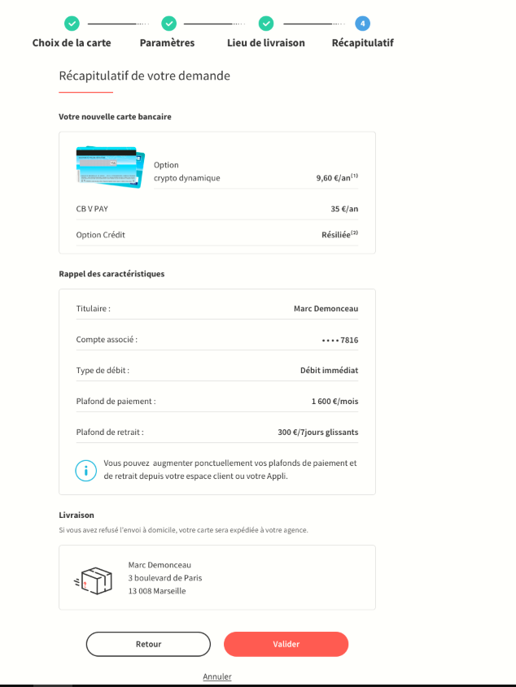
the full picture

Slide 29
SGC+ SGStep
SGC+ SGTitle
Organism : NewCardView
SummaryView
Organism : CharacteristicsView
SummaryPage
Organism : DeliveryView
Molecule : EtapeFooter

Slide 30
Sgc+
<SGButton type="secondary" onClick={() => console.log('Primary button clicked')} > Primary Button </SGButton>
<SGTitle level={2} visualLevel={4} > Titre </SGTitle>
http://socle.applis.bad.socgen/icd/static/sg-components-plus/latest/?path=/story/sg-components-ui-kit--pr%C3%A9sentation
<SGText type="amount" size="xl" strong > 0 € </SGText>

Slide 31
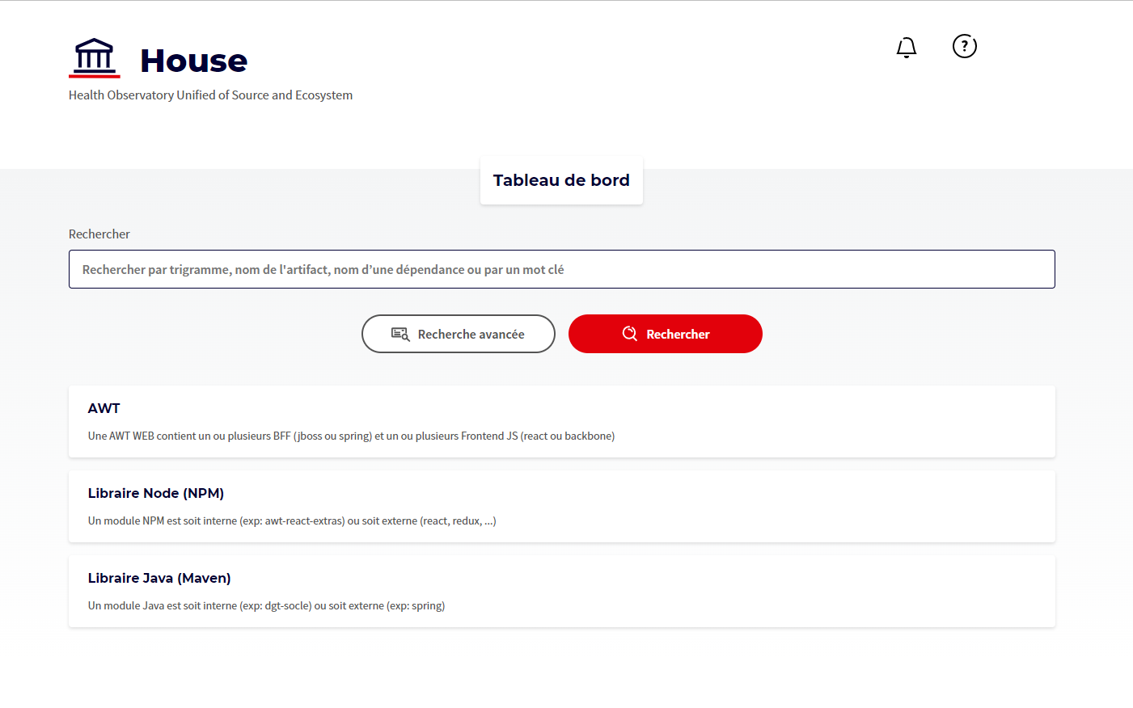
the full picture

Slide 32
House dashboard page
class HouseDashboardPage extends Component { // default props static defaultProps = { onDashboardItemClicked: null, }; // propsType (validation) static propTypes = { onDashboardItemClicked: PropTypes.func, }; componentDidMount() { } onRechercheSimpleClicked = (searchText) => { navigateToPage( this.props, Path.HOUSE_RECHERCHE_SIMPLE, `an2000_searchText=${encodeBase64UrlParam(searchText)}`, null, false ); }; onRechercheAvanceeClicked = () => { navigateToPage( this.props, Path.HOUSE_RECHERCHE_AVANCEE, null, null, false ); }; render() { const { onDashboardItemClicked, } = this.props; return ( <HouseDashboardView onDashboardItemClicked={onDashboardItemClicked} onRechercheSimpleClicked={this.onRechercheSimpleClicked} onRechercheAvanceeClicked={this.onRechercheAvanceeClicked} /> ); } }
Container Component.
Container Components care about what data is shown to the user.
The primary function of container components is to pass data to presentational components, which they contain.
Container components themselves usually don't render any other components besides the presentational components that care about their data.
Since they don't render anything themselves, they usually do not contain any styling either.
Only Page must be a class.
We shouldn’t have any UI logic or state inside page.
Some side effects (http requests, navigation) are authorized.
https://www.patterns.dev/posts/presentational-container-pattern

Slide 33
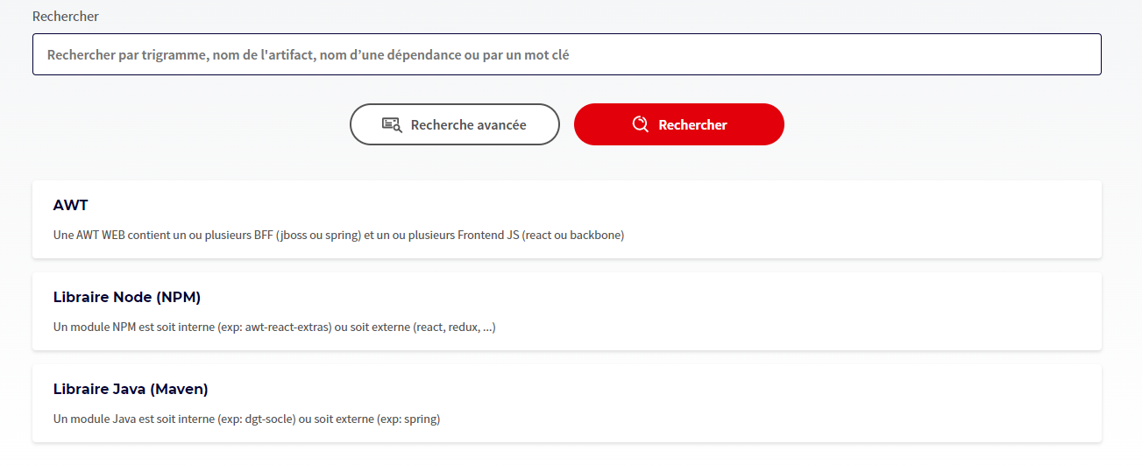
House dashboard view
const HouseDashboardView = ({ onDashboardItemClicked, onRechercheSimpleClicked, onRechercheAvanceeClicked, }) => ( <> <HouseSearchBar testpath="../js/commons/components/HouseSearchBar" onRechercheSimpleClicked={onRechercheSimpleClicked} onRechercheAvanceeClicked={onRechercheAvanceeClicked} /> <SGRadioGroup name="house_menu_item" buttonstyle="tile" layout="column" showradio={false} datasource={HOUSE_DASHBOARD_DATASOURCE} onChange={(event) => onDashboardItemClicked(event.target.value)} > {HOUSE_DASHBOARD_DATASOURCE.map((item) => ( <SGRadio key={item.value} value={item.url} autoFocus={item.autoFocus} defaultChecked={item.defaultChecked} > <SGText titlerender> {item.label} </SGText> <SGBox margin={{ top: 'xs', }} > <SGText size="s"> {item.description} </SGText> </SGBox> </SGRadio> ))} </SGRadioGroup> </> );
Presentational Component.
Presentational Components care about how data is shown to the user.
A presentational component receives its data through props.
Its primary function is to simply display the data it receives the way we want them to, including styles, without modifying that data.
Only UI.
Only useState.
It must be a pure functional component (inputs are immutable).
Side effects are not authorized.
Don’t forget to clean timer, interval and event.
https://www.patterns.dev/posts/presentational-container-pattern

Slide 34
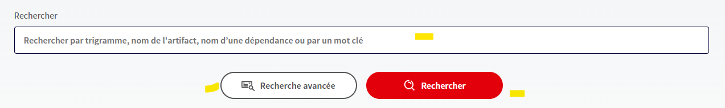
House search bar
const HouseSearchBar = ({ words, defaultSearchText, onRechercheLiveChanged, onRechercheSimpleClicked, onRechercheAvanceeClicked, }) => ( <> <SGInput allowClear buttontype="secondary" label={words.HOUSE_SEARCHBAR_INPUT_LABEL} placeholder={words.HOUSE_SEARCHBAR_INPUT_PLACEHOLDER} value={houseSearchText} validate={houseSearchTextError} status={houseSearchTextError ? 'error' : 'default'} onChange={(event) => { setHouseSearchText(event.target.value); setHouseSearchTextError(null); if (onRechercheLiveChanged) { onRechercheLiveChanged(event.target.value); } if (!event.target.value) { if (onRechercheSimpleClicked) { onRechercheSimpleClicked(event.target.value); } } }} /> <SGButtonGroup align="center" layout="row" > {onRechercheSimpleClicked && ( <SGButton aria-label="recherche_simple" icon={( <SGIcon component={<SGAvenirStrokedLoupe />} currentcolor /> )}
Presentational Component.
Presentational Components care about how data is shown to the user.
A presentational component receives its data through props.
Its primary function is to simply display the data it receives the way we want them to, including styles, without modifying that data.
Only UI.
Only useState.
It must be a pure functional component (inputs are immutable).
Side effects are not authorized.
Don’t forget to clean timer, interval and event.
https://www.patterns.dev/posts/presentational-container-pattern

Slide 35

House header view
const HouseHeaderView = LocalizedFragment(CommonsDico)(({ words, notificationCount, onNotificationClicked, onHelpClicked, }) => ( <SGGridRow> <SGGridCol > <SGTitle> <SGIcon component={<SGAvenirStyledSecteurPublic />} /> <SGBox inline margin={{ left: 'md', }} > {words.HOUSE_TITLE} </SGBox> </SGTitle> <SGBox margin={{ bottom: 'md', }} > <SGText> {words.HOUSE_TITLE_LEGENDS} </SGText> </SGBox> </SGGridCol> <SGGridCol textalign="right" > <SGButton disableautomargin aria-label="bouton_notification" icon={( <SGBadge count={notificationCount}> <SGIcon
Presentational Component.
Presentational Components care about how data is shown to the user.
A presentational component receives its data through props.
Its primary function is to simply display the data it receives the way we want them to, including styles, without modifying that data.
Only UI.
Only useState.
It must be a pure functional component (inputs are immutable).
Side effects are not authorized.
Don’t forget to clean timer, interval and event.
https://www.patterns.dev/posts/presentational-container-pattern

Slide 36
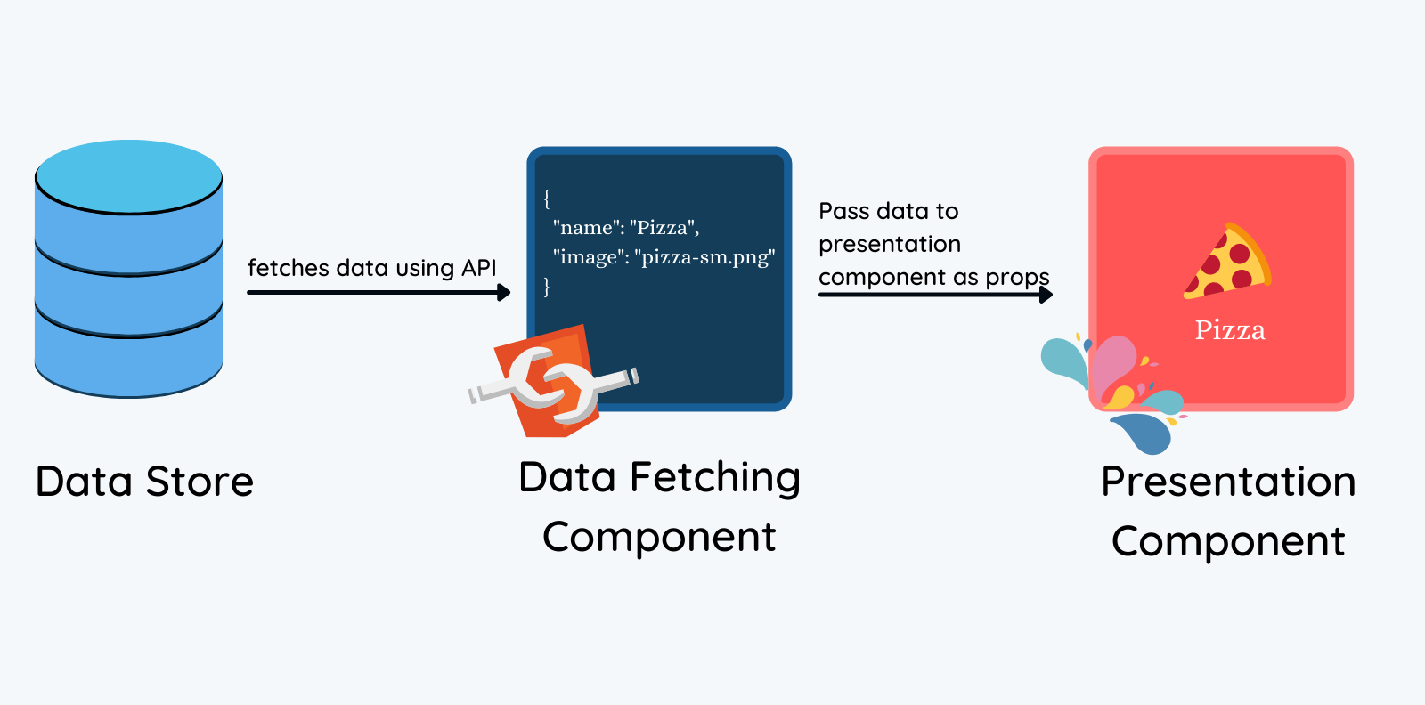
Let’s sum up
Page
Component

Slide 37
Let’s sum up
HouseNpmLibDetailsPage
HouseNpmLibDetailsView
HouseNpmInfosView
HouseNpmLibUsedOnView
Page
Composant de premier niveau (View)
Components
(List, Table, Card, …)
HouseNpmLibImportedOnView
HouseNpmLibTimeline
UsedOnList
UsedOnListItem

Slide 38
Application organization
HTTP Requests
Redux (purify outside side effects)
Page (Class)
Main Component
(Pure Function)
Component 1 (Pure Function)
Component 2 (Pure Function)
Commons & Utils

Slide 39
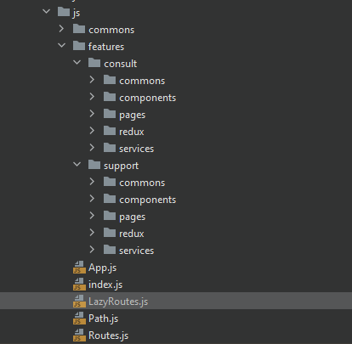
Application organization
Saga
Redux
Pages
Components (pure domain)
http Services

Slide 40
What about form ?
const HouseSearchBar = ({ words, defaultSearchText, onRechercheLiveChanged, onRechercheSimpleClicked, onRechercheAvanceeClicked, }) => { const [ houseSearchText, setHouseSearchText, ] = useState(null); const [ houseSearchTextError, setHouseSearchTextError, ] = useState(null); return ( <> <SGInput allowClear buttontype="secondary" label={words.HOUSE_SEARCHBAR_INPUT_LABEL} placeholder={words.HOUSE_SEARCHBAR_INPUT_PLACEHOLDER} value={houseSearchText} validate={houseSearchTextError} status={houseSearchTextError ? 'error' : 'default'} onChange={(event) => { setHouseSearchText(event.target.value); setHouseSearchTextError(null);
}} />
Define states
Read current states
Update states

Slide 41
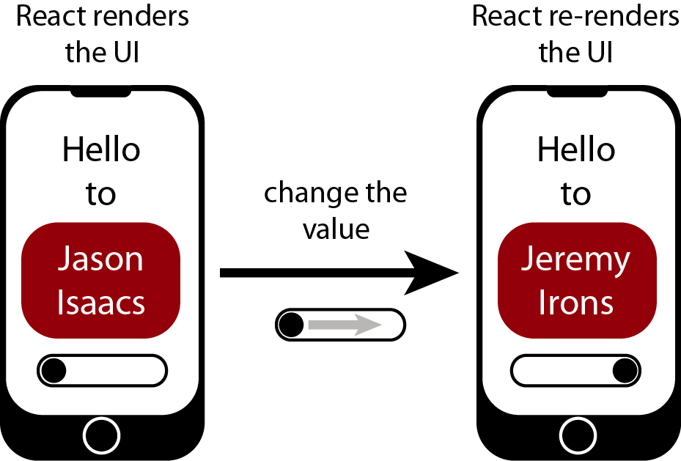
State update

Slide 42
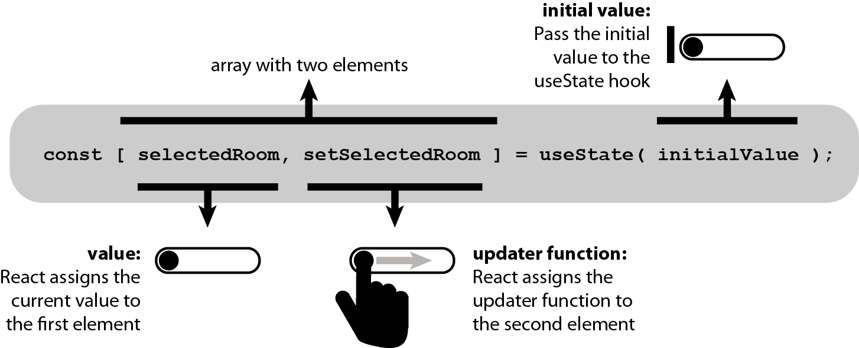
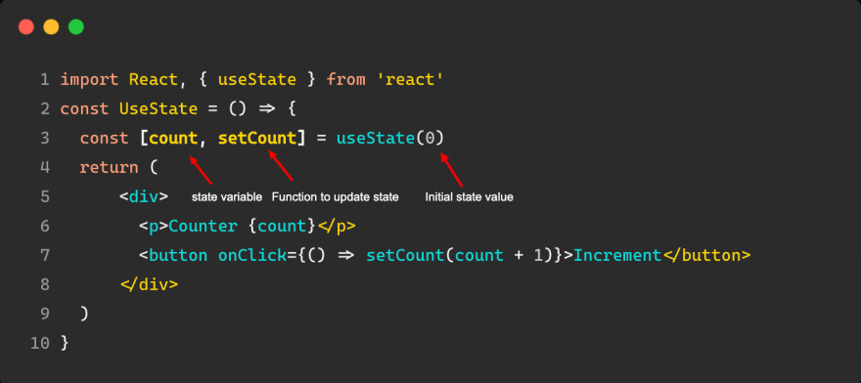
Usestate

Slide 43
rule
State is mutable
State is local

Slide 44
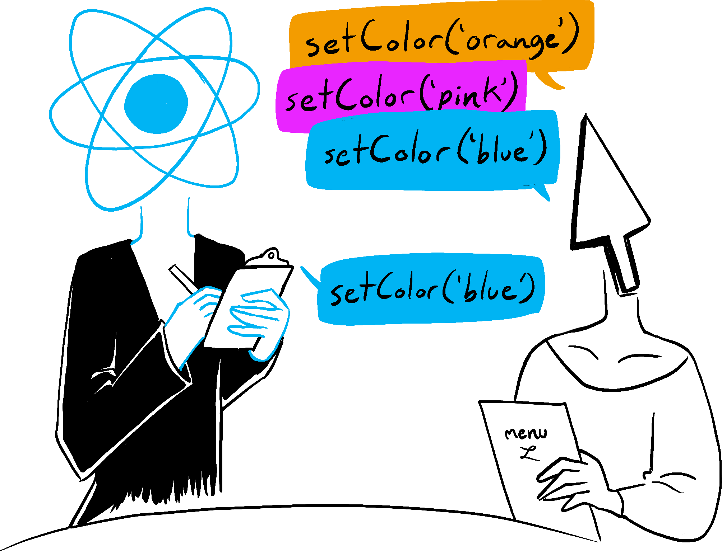
State Updates May Be Asynchronous
State updates in React are asynchronous; when an update is requested, there is no guarantee that the updates will be made immediately.
The updater functions enqueue changes to the component state, but React may delay the changes, updating several components in a single pass (batch updates).
We cannot read state immediately.
https://react.dev/learn/queueing-a-series-of-state-updates

Slide 45
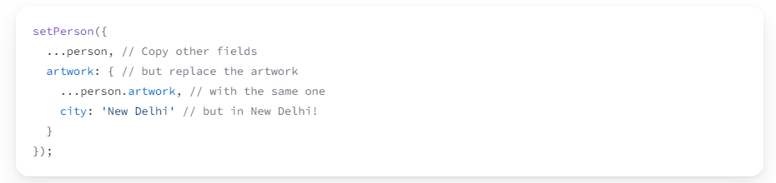
Updating Objects in State
https://react.dev/learn/updating-objects-in-state

Slide 46
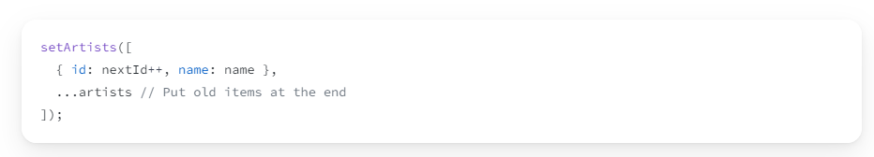
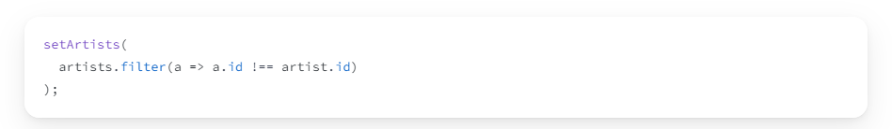
Updating Arrays in State
https://react.dev/learn/updating-arrays-in-state

Slide 47
Simple & advanced Form Logic
For performance reasons, it is recommended to attach a useState to each dynamic form component rather than having a single state.
If the form validation logic is complex, it is recommended to outsource the validation logic to a utility or use a solution based on Formik and Yup.
Using Redux-Form is not recommended.
https://xblocks.socgen/#/client/awt-react-formulaire-simple.md
https://xblocks.socgen/#/client/awt-react-formulaire-plusieurs-etapes.md

Slide 48
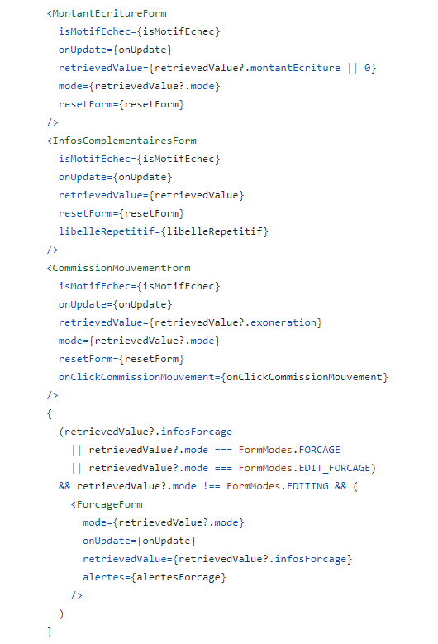
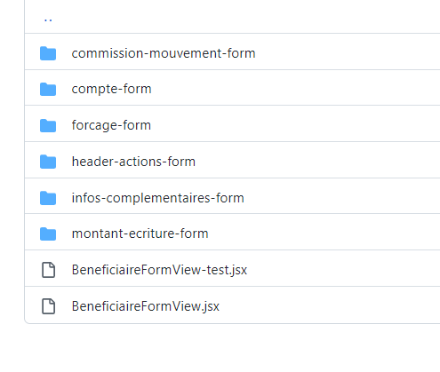
Split form
Dont’: Large form.
Do: Split, Locate state and lazy load if needed.

Slide 49
Rules
The use of LocalStorage is not allowed.
The use of cookie and session is not allowed.
BFF is used to cache temporary data.

Slide 50
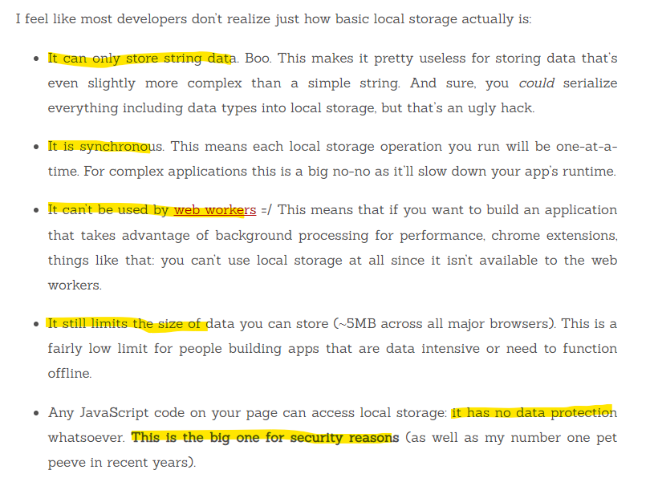
Stop using local storage
Stop Using Local Storage

Slide 51
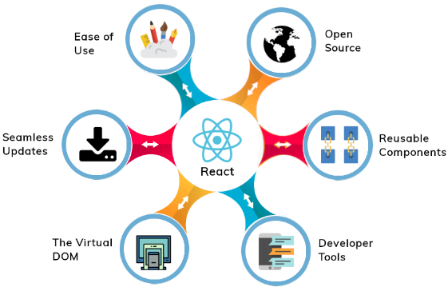
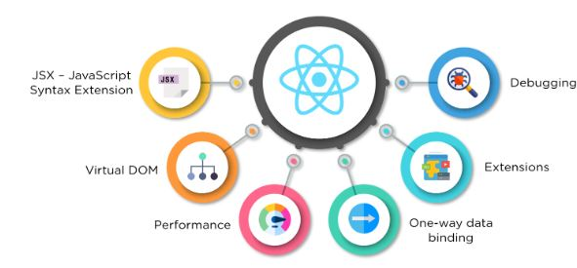
React : an inside view

Slide 52
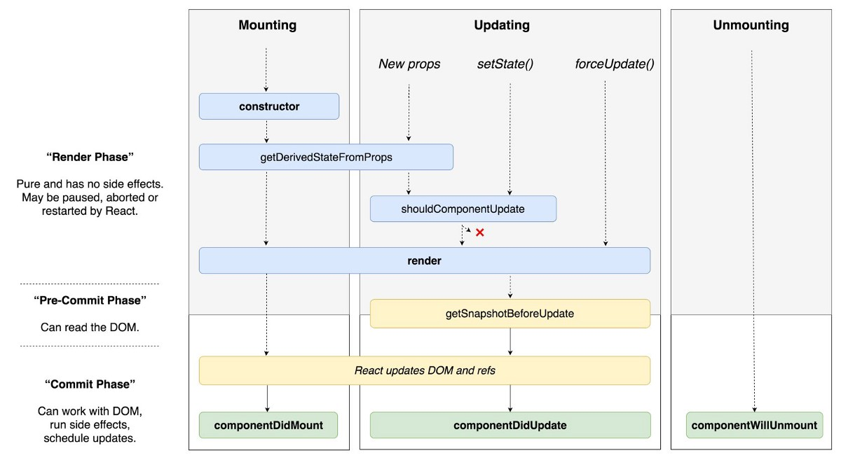
React Life Cycle

Slide 53
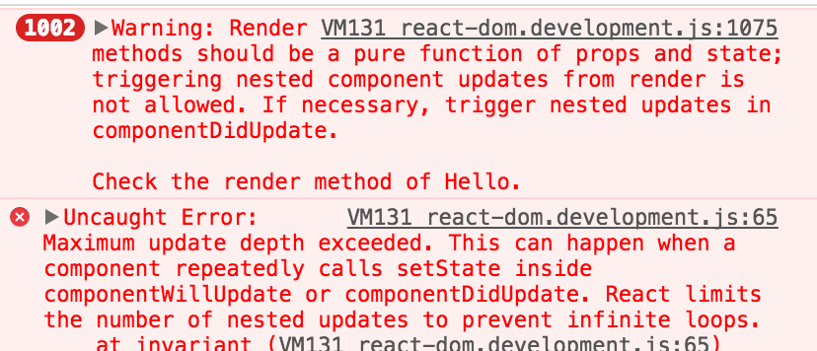
Render must be pure
Routing should not be done at the render level.
The call to http services should not be made at the render level.
Instead, use componentDidUpdate or componentDidMount.
http://xblocks.socgen/icd/demo/#/client/awt-react-formulaire-plusieurs-etapes?id=phase-3-prise-en-compte-du-r%c3%a9sultat-de-la-soumission-du-formulaire-1

Slide 54
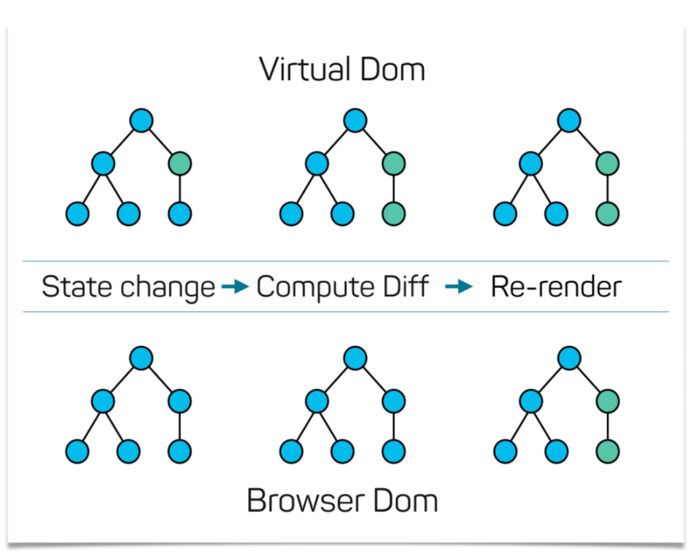
React virtual DOM

Slide 55
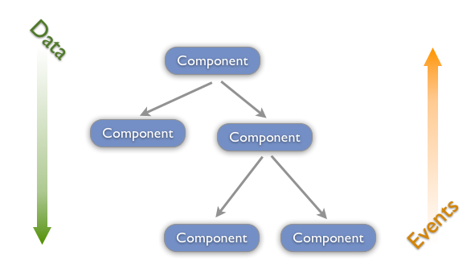
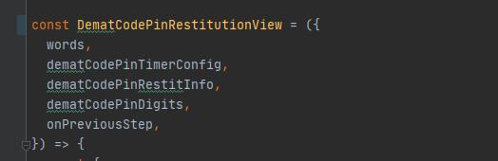
Top Down Data Flow
Child :
data
event
Parent :
return ( <DematCodePinRestitutionView dematCodePinRestitInfo={dematCodePinRestitInfo} dematCodePinDigits={dematCodePinDigits} dematCodePinTimerConfig={codePinTimerConfig()} onPreviousStep={this.onPreviousStepCallback} /> ); } } export default DematCodePinRestitutionPage;
onPreviousStepCallback = () => { navigateToCaracteristiquesCarteWebUrl(this.props); };

Slide 56
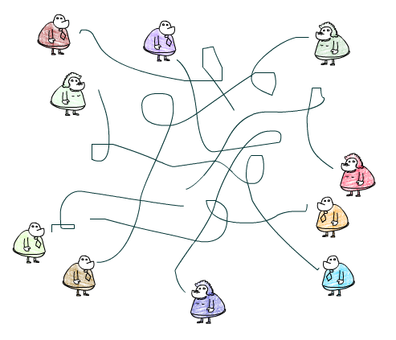
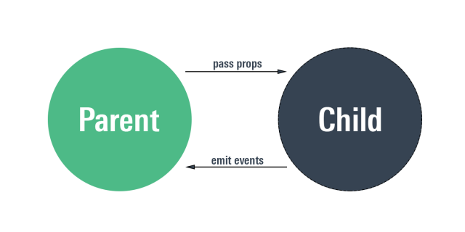
One way data binding

Slide 57

React do/Don't
Patterns & Anti-Patterns

Slide 58
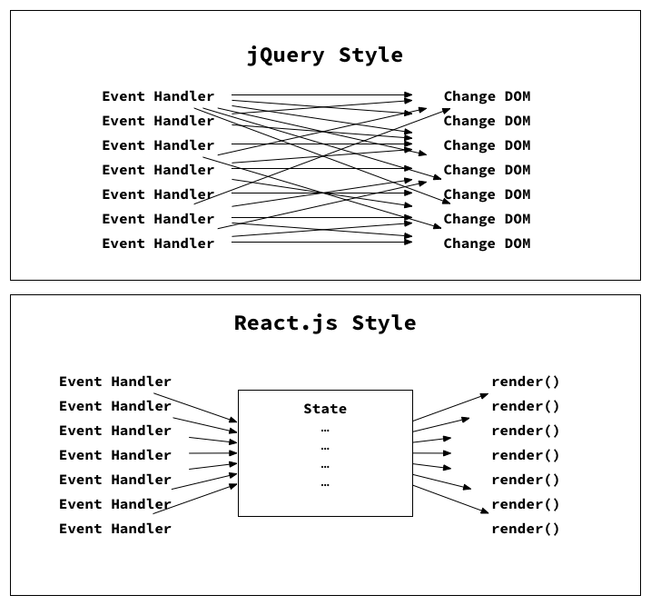



Slide 59
composition
import React from 'react';
const UserList = ({
users,
onUserClick,
}) => (
<>
{users && users.map(user =>
<UserRow
user={user}
onUserClick={onUserClick}
/>
)}
</>
);
export default UserList;
const UserRow = ({ user }) => {
const {
firstName,
lastName,
} = user;
return (
<div>
<span>{firstName}</span>
<span>{lastName}</span>
</div>
)
}
JS
X

Slide 60
Semi - React
const UserList = ({
users,
onUserClick,
}) => (
<ul>
{users.map((user) => {
const {
firstName,
lastName,
} = user
return (
<li>
<div>
<span>{firstName}</span>
<span>{lastName}</span>
<button
onClick={onUserClick}
>
Select User
</button>
</div>
</li>
)
})}
</ul>
)
Dont’: Big Components.
Do: Composition, Progressive Abstraction.

Slide 61
Don’t touch the dom !
document.getElementsByTagName('span')
document.querySelectorAll('#nav a:nth-child(odd)')
$('.box, .thumbs', '#product').fadeIn(1000)

Slide 62
ReactDom.render should appear only one time : to boot application
if (document.getElementById(‘XXX')) { const newDiv = document.createElement(‘XXX'); newDiv.setAttribute('id', ‘XXX'); document.getElementsByClassName(‘XXXXXXXXX')[0].appendChild(newDiv); } const element = document.getElementById(‘XXXXXXX') || document.getElementById(‘XXXXXXX'); if (component === A') { ReactDOM.render(<ComponentA />, element); } if (component === ‘B') { ReactDOM.render(<ComponentB />, element); }

Slide 63
Config & utils
<HouseAwtEvolutionsView testpath="../app/components/awt/HouseAwtEvolutionsView" evolutions={getFrontendEvolutions(awt)} onEvolutionClicked={onEvolutionClicked} />
<HouseAwtDependenciesView testpath="../app/components/awt/HouseAwtDependenciesView" dependencies={getFrontendDependencies(awt)} onDependencyClicked={onDependencyClicked} />
const HouseConfig = { TIMELINE_SETTINGS, HOUSE_DASHBOARD_DATASOURCE, HOUSE_BFF_URL, HOUSE_QUERY_CONFIG, HOUSE_QUERY_PAGE_SIZE, AWT_DETAILS_DEPS_FILTERS, exportAwtDataToCSV, isAwtReact, getFrontendDependencies, getFrontendEvolutions, getAwtStatsCategories, getAwtStatsSeriesByCategory, filterDependencies, buildBackUrlParams, buildAwtDetailsUrlParams, updateAwtStatsSeries, formatNpmPackageInfos, buildNpmDetailsUrlParams, exportNpmDataToCSV, }; export default HouseConfig;
Dont’: Format data in components.
Do: Use Configs and Utils (DRY).

Slide 64
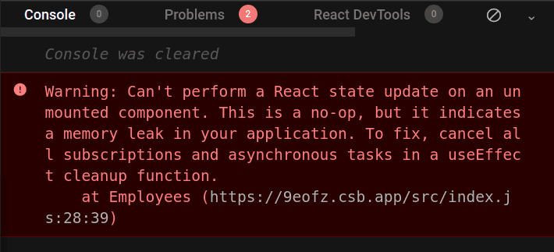
DON’T: setTimeout & setInterval without clean
const MonComposant = () => { const [ count, setCount, ] = useState(0); useEffect(() => { const timer = setTimeout(() => { setCount('Timeout called!'); }, 1000); return () => clearTimeout(timer); }, []); return ( <span> Current Count: {count} </span> ); }; export default MonComposant;
const MonComposant = () => { const [ countInterval, setCountInterval, ] = useState(0); useEffect(() => { const interval = setInterval(() => { setCountInterval(countInterval + 1); }, 1000); return () => clearInterval(interval); }, []); return ( <span> Current Count: {countInterval} </span> ); }; export default MonComposant;

Slide 65
DON’T: addEventListener without clean
class MyComponent extends React.Component { constructor(){ super(props) this.handleClick = this.handleClick.bind(this) } handleClick = () => { //do something when we clicked } componentDidMount() { document.addEventListener("mousedown", this.handleClick); } componentWillUnMount() { document.removeEventListener("mousedown", this.handleClick); } render() { renturn ... } } export default MyComponent
import React, { useEffect, } from 'react'; const MonComposant = () => { const handleKeyDown = (event) => { console.log('A key was pressed', event.keyCode); }; useEffect(() => { window.addEventListener('keydown', handleKeyDown); // cleanup listener return () => { window.removeEventListener('keydown', handleKeyDown); }; }, []); return ( <span> Hello ! </span> ); }; export default MonComposant;
https://github.com/facebook/react/issues/12947

Slide 66
DON’T: async call & promise inside presentational component
const [isVisible, setIsVisible, ] = useState(true); useEffect(() => { let cancel = false; someAsyncFunction().then(() => { if (cancel) return; setIsVisible(false); }); return () => { cancel = true; }; }, []);

Slide 67
DON’T: routing inside presentational component
import React from 'react'; import { NavigationUtils, } from 'awt-react-extras'; const { navigateToPage, } = NavigationUtils; const MonComposant = () => ( <> <span> Hello ! </span> <button onClick={() => { navigateToPage( { history, }, url, null, null, false ); }} /> </> ); export default MonComposant;
import React from 'react'; const MonComposant = ({ onValidateClicked, }) => ( <> <span> Hello ! </span> <button onClick={() => onValidateClicked()} /> </> ); export default MonComposant;

Slide 68
DON’T: Using "data.map" for all list cases
It all depends on the amount of data to display.
If the amount of data is limited in PROD (<= 10 elements), map can be used.
If the amount of data exceeds 10 elements, these techniques are preferred:
SGList with Load more
SGList or SGTable with pagination
SGList Infinite (window)
https://socle.applis.bad.socgen/icd/static/sg-components-plus/latest/?path=/docs/2-0-avenir-2-4-molecules-sglist-listcomplexe-listafficherplus--list-afficher-plus

Slide 69

React tips

Slide 70
Conditional Rendering
{(errorType === SOU_CDG_ELIGIBLE_CARD_LIST_EMPTY) && ( <NoActiveCardView message={(({ SOU_CDG_NO_CARD_MESSAGE, }) => (SOU_CDG_NO_CARD_MESSAGE) )(words || {})} onButtonClicked={onCallback} /> )} {(errorType === SOU_CDG_ELIGIBLE_CARD_LIST_SAME_AS_CIBLE) && ( <SouCdgSameCardsAsCibleMessageView onCancel={onCancel} onSeeMore={onSeeMore} onUpgrade={onUpgrade} typeCarteIdCible={typeCarteIdCible} /> )} {(errorType === SOU_CDG_USER_NOT_ELIGIBLE) && ( <NoRightsView message={(({ SOU_CDG_NO_RIGHTS_MESSAGE, }) => (SOU_CDG_NO_RIGHTS_MESSAGE) )(words || {})} onButtonClicked={onCallback} /> )}
const souCdgNewCardContent = { [SOU_CHANGEMENT_GAMME]: <SouCdgNewCardFicheProduitView typeCarteIdCible={typeCarteIdCible} />, [SOU_VOYAGEUR]: <SouCdgNewCardFicheVoyageurView typeCarteIdCible={typeCarteIdCible} />, [SOU_COLLECTION]: <SouCdgNewCardCatalogueCollectionView typeCarteIdCible={typeCarteIdCible} />, };
{!isSameCardSelected && ( <> {souCdgNewCardContent[parcoursId]} </> )}
If condition then

Slide 71
Conditional Rendering
{showTermsOption ? ( <OptionInlineMessage showTitle={false} showLegend={false} optionLabel={termsOptionLabel} message={termsMessage} conditionLabel={termsConditionLabel} isTermsChecked={isTermsChecked} onTermsChange={({ target: { checked, }, }) => setTermsChecked(checked)} /> ) : ( <InlineMessage kind={isSameCardSelected ? 'error' : 'info' } > {selectCardInfoMessage} </InlineMessage> ) }
If /else

Slide 72
Conditional Rendering
<> (errorType === SOU_CDG_ELIGIBLE_CARD_LIST_EMPTY && ( <NoActiveCardView message={(({ SOU_CDG_NO_CARD_MESSAGE, }) => (SOU_CDG_NO_CARD_MESSAGE) )(words || {})} onButtonClicked={onCallback} /> )) || (errorType === SOU_CDG_ELIGIBLE_CARD_LIST_SAME_AS_CIBLE && ( <SouCdgSameCardsAsCibleMessageView onCancel={onCancel} onSeeMore={onSeeMore} onUpgrade={onUpgrade} typeCarteIdCible={typeCarteIdCible} /> )) || (errorType === ERR_FUNC_USER_NON_ELIGIBLE && ( <NoRightsView message={(({ SOU_CDG_NO_RIGHTS_MESSAGE, }) => (SOU_CDG_NO_RIGHTS_MESSAGE) )(words || {})} onButtonClicked={onCallback} /> )) || ( <ErrorMessageView onButtonClicked={onCallback} /> )} </>
switch / default

Slide 73
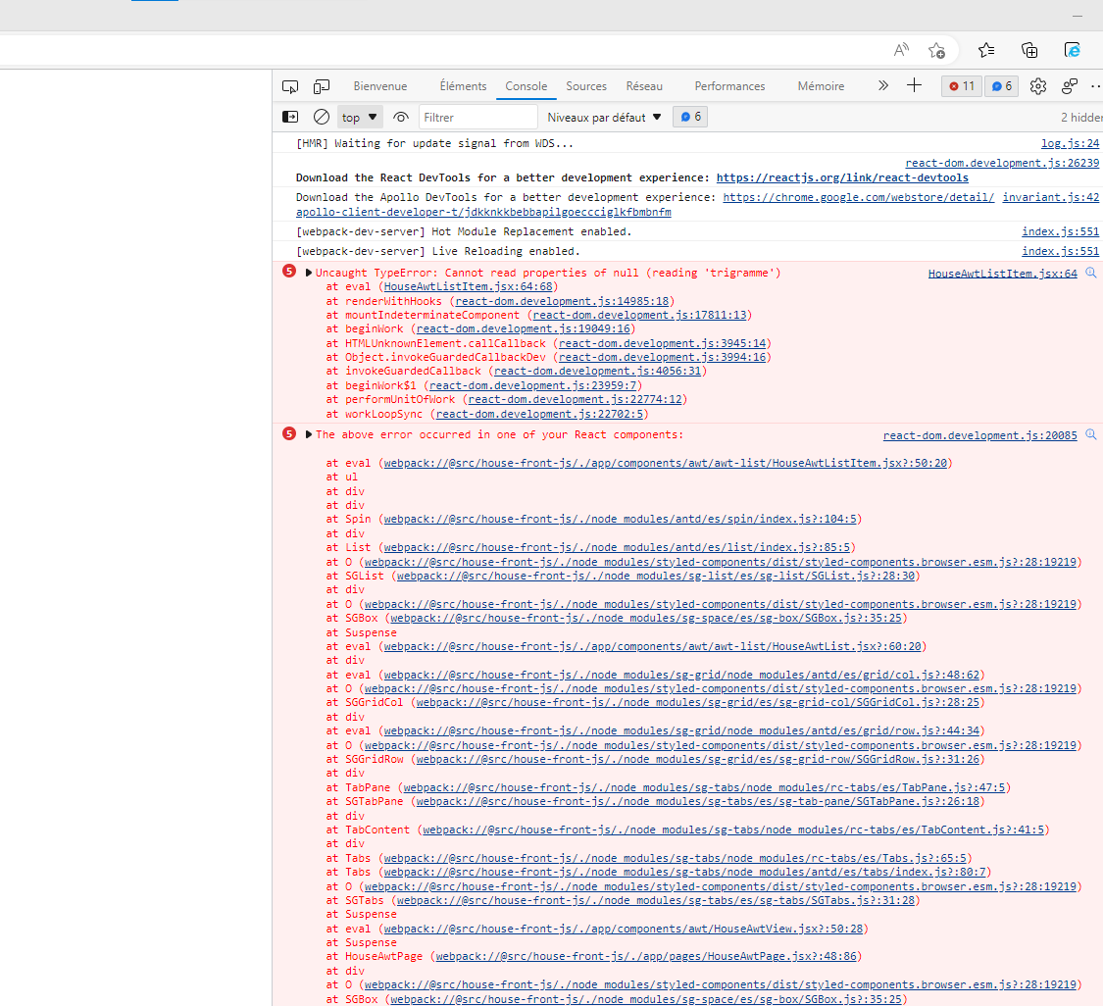
React Patterns – Error Boundary

Slide 74

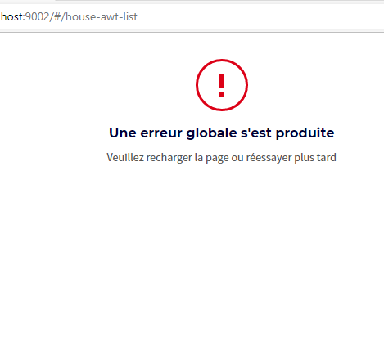
React Patterns – Error Boundary
class ErrorBoundary extends React.Component { // default props static defaultProps = { words: {}, }; // propsType (validation) static propTypes = { words: PropTypes.shape({ HOUSE_GLOBAL_ERROR_TITLE: PropTypes.string, HOUSE_GLOBAL_ERROR_MESSAGE: PropTypes.string, }), }; constructor(props) { super(props); this.state = { hasError: false, }; } static getDerivedStateFromError() { return { hasError: true, }; } componentDidCatch(error, errorInfo) { // eslint-disable-next-line no-console console.log(error, errorInfo); } render() { const { hasError, } = this.state; const { words, } = this.props; if (hasError) { return ( <HouseErrorView title={words.HOUSE_GLOBAL_ERROR_TITLE} message={words.HOUSE_GLOBAL_ERROR_MESSAGE} /> ); } return ( <WrappedComponent {...this.props} /> ); } }
Périmètres d'erreurs – React (reactjs.org)
https://sgithub.fr.world.socgen/SocleDigitalClient/sg_web_dgt_house/blob/develop/src/packages/house-front-js/js/commons/hocs/withGlobalError.jsx#L9

Slide 75
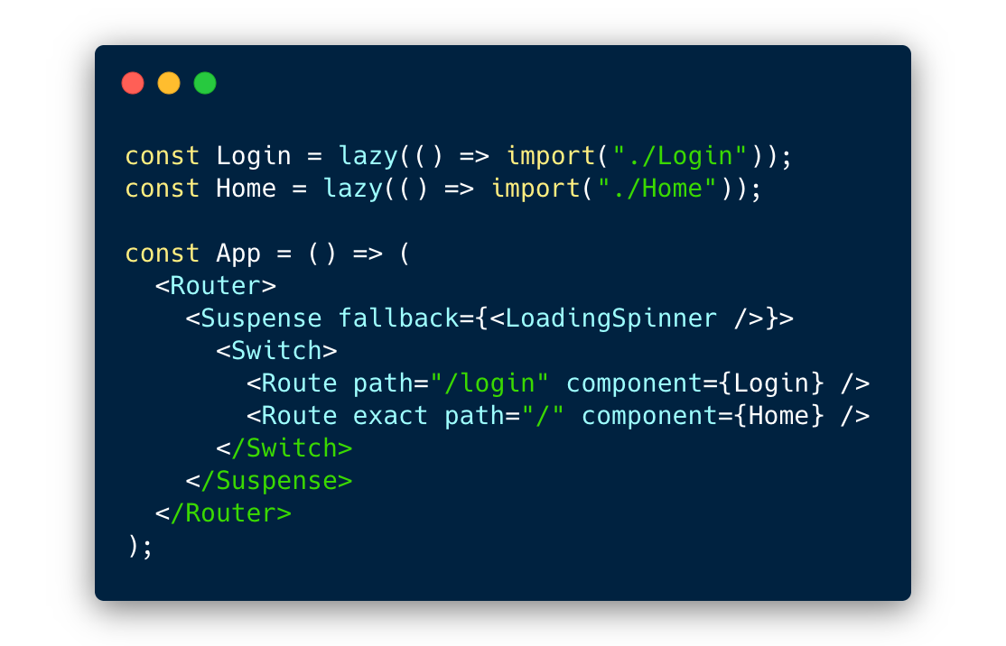
Lazy Routes
import { lazy } from 'react'; const ViperSuiviPage = ( lazy(() => ( import('./features/viper/pages/ViperSuiviPage') )) ); const ViperDetailsPage = ( lazy(() => ( import('./features/viper/pages/ViperDetailsPage') )) );
<Suspense fallback={<div />}> <Router> <Switch> <Route path={VIPER_SUIVI_PATH} component={ViperSuiviPage} /> <Route path={VIPER_SAISIE_PATH} component={ViperSaisiePage} />

Slide 76
Lazy Component
return ( <Suspense fallback={<LoadingView />}> <ViperSaisieForm configuration={configuration} isViperSouscris={isViperSouscris} isHabilitationSaisieViper={isHabilitationSaisieViper} formLoading={loading} emetteurs={emetteurs} periodicities={periodicities} beneficiaire={beneficiaire} datesEcheance={datesEcheance} dateEndMax={dateEndMax} montantMax={montantMax} chooseBeneficiaire={() => this.chooseBeneficiaire()} editBeneficiaire={(values, beneficiaireValue) => this.editCNABeneficiaire( values, beneficiaireValue )} beneficiaireCNAError={beneficiaireValue => this.beneficiaireCNAError( beneficiaireValue )} abandonnerViper={() => this.abandonnerConfirmViper()} confirmerViper={virement => this.confirmViper(virement)} confirmViperWithError={error => this.confirmViperWithError(error)} /> </div> </Suspense>
// lazy load saisie form const ViperSaisieForm = ( lazy(() => ( import('../components/viper-saisie/ViperSaisieForm') )) );

Slide 77
Be carefull
lazy should always be used with Suspense (placeholder).
The loader is important to mark the loading of the component (Optimistic UI).
Passing through lazy and Suspense will automatically create (without any additional configuration) a separate chunck for the component which will be loaded on demand and in parallel.
For webpack to be able to properly split the bundle, it must be ensured that the component is only called in lazy mode: it is not imported in an ordinary way or referenced in an index or a particular file.
(an ordinary import + a lazy import => the ordinary import will gain)

Slide 78

Let’s see some code !

Slide 79

Thinking in React
Step 1: Break The UI Into A Component Hierarchy
Step 2: Build A Static Version in React (don’t use state at all to build this static version)
Step 3: Add get Backend call (how data is fetched ?)
Step 4: Add actions (onClick, onChange) and submit Backend request (Put, Post, ...)
http://socle.applis.bad.socgen/icd/demo/#demo/docs/client/awt-v4-phases-developpement-react.md

Slide 80

BDDF SOCLE 2023

Slide 81
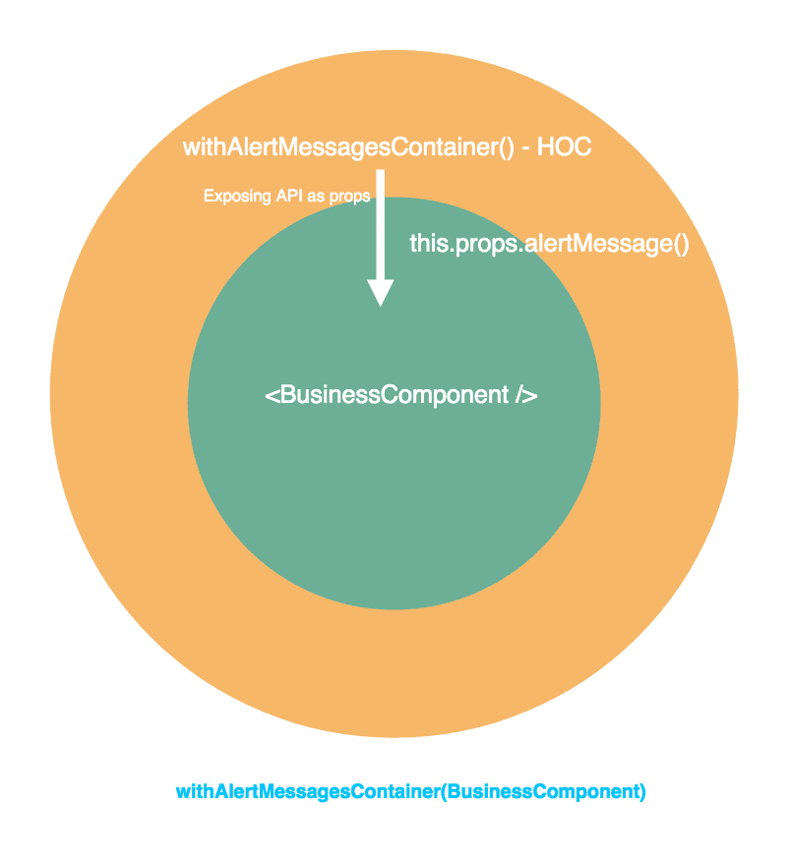
HOC & HOOKS
Next Session

Slide 82
Browsers & React
Internally
Dedicated Session

Slide 83
React DevTools
Dedicated Session

